Slide 1
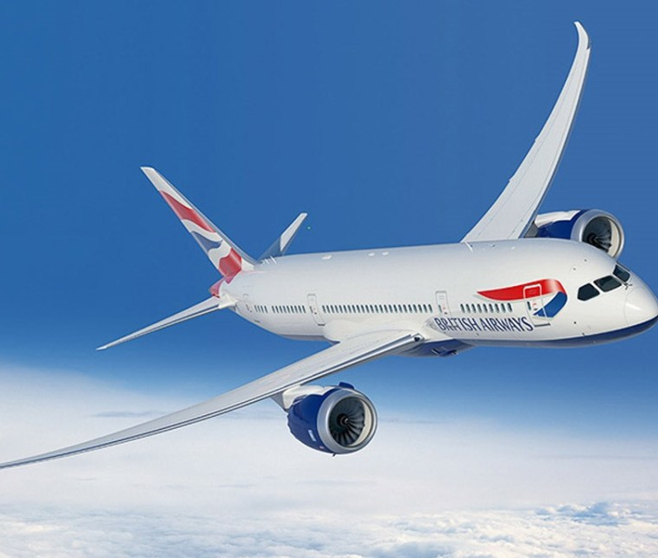
British Airways
Customer Booking Analysis
This Photo by Unknown author is licensed under CC BY-SA.

Slide 2
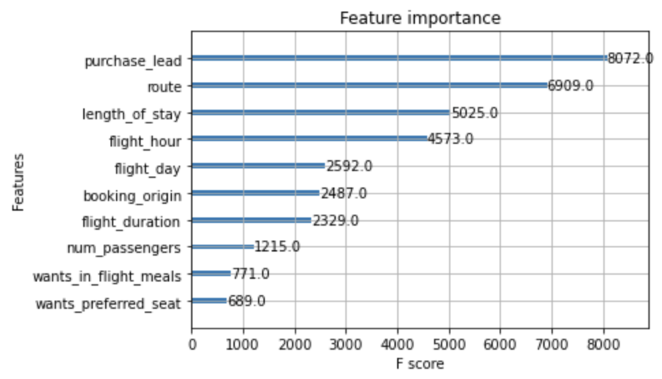
Prediction model to understand the factors influence customer booking
We trained data on Random Forest Classifier model and receive
Accuracy score 85%
F1 score of 25%
Factors influence booking are:-
Purchase Lead
Route
Length of stay
Flight hour
Flight day
Booking origin
As the model is trained with unbalanced data, 85% of it leads to incomplete bookings and only 15% to confirmed bookings, we need more data to increase its accuracy.

